Slide 1
Fake Base Station Detection At Network Side
Date: 03 Jul’ 2025
(COD 893) Mtech Project - II
Guide: Prof. Vireshwar Kumar
Bhuvnesh Kumar (2023MCS2011)

Slide 2
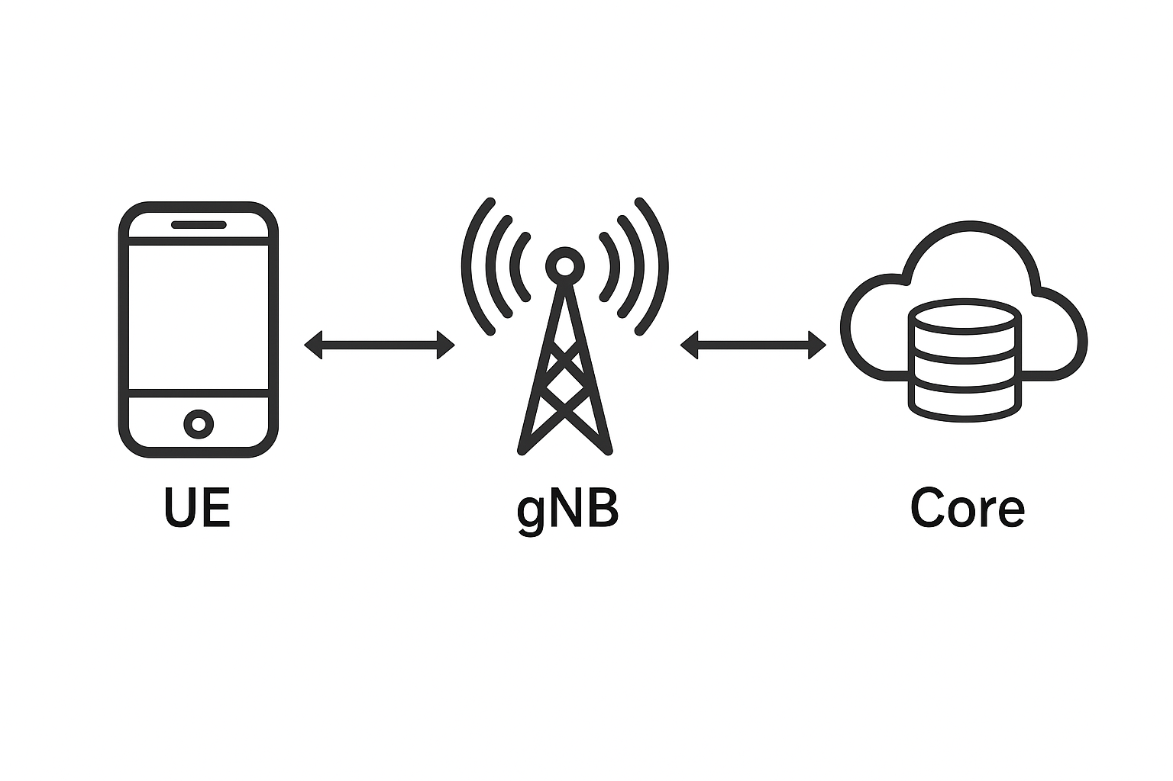
Introduction: Cellular Architecture
User Equipment (UE): End-user device (Mobile Phones) communicates wirelessly with gNB.
gNB (5G Base Station): Connects UEs to 5G Core over the air.
5G Core (5GC): it is the cloud-native brain of 5G networks.

Slide 3
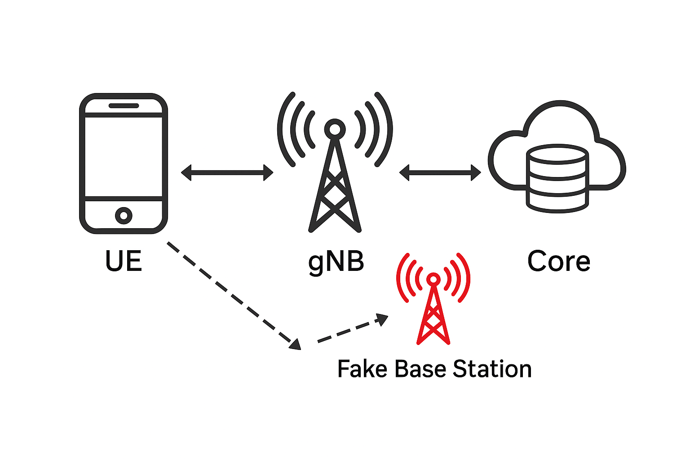
What is a Fake Base Station (FBS)?
Unauthorized radio transmitters that mimic legitimate base stations, tricking mobile devices into connecting to it instead of a legitimate base station.
Capabilities: Broadcasts cloned PCI, SSB, SIBs, manipulates power.
Attack: Exploits UE behavior of connecting to strongest signal before authentication.

Slide 4
Motivation
Launch attacks on mobile devices and network
Privacy Invasion
Data Interception
Denial of Service (DoS)
Message Spoofing or Manipulation
Phishing and Malware
Notes:
FBS are a big risks to the privacy of User devices.
They can intercept the calls, messages and data traffic.
They can prevent the nearby UEs to connect to the legitimate base stations which can can cut off calling, messaging and emergency services).
Attackers can broadcast fake messages, which can cause confusion among the people.
Using the fake captive portals Users can be tricked to enter the credentials and download the malicious apps.

Slide 5
Challenges
FBS are difficult to detect
Behaviour is very similar to Benign Base station.
UE side detection
Local view.
Cannot reliably distinguish FBS and Benign base stations based on power.

Slide 6
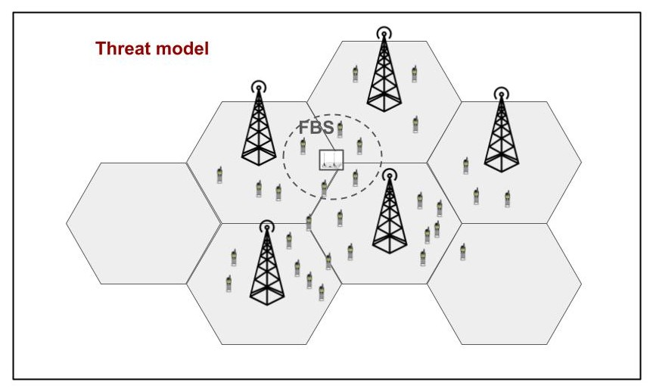
Problem Statement
Detection of FBS at Network side using measurement reports.
Notes:
Mobile phones scan all the signal received from the neighbour base stations and connect to strongest signal without any verification of gNB, FBS takes a\dvantage of this and trap the UEs to connect to them.

Slide 7
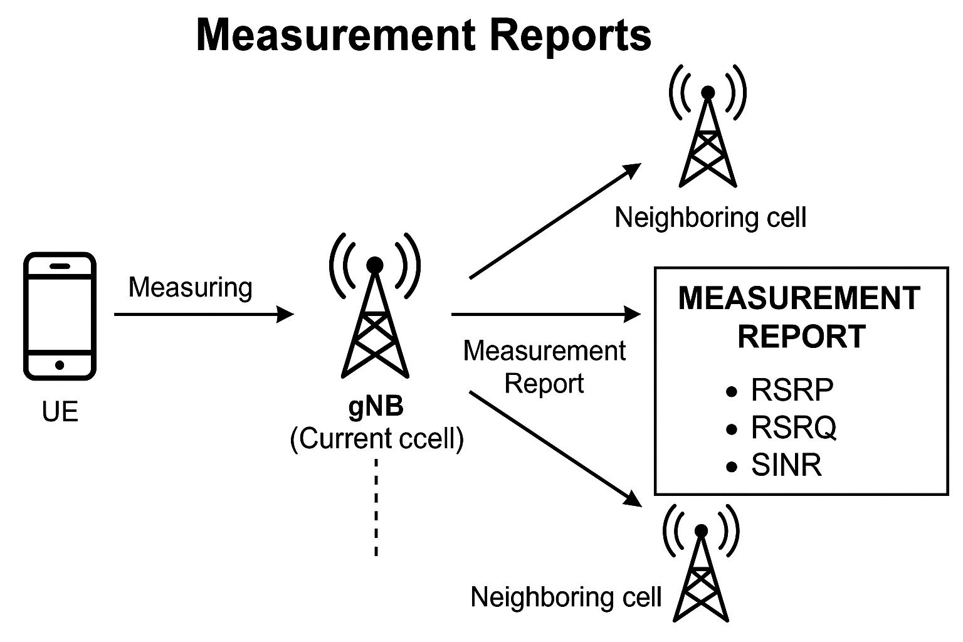
Measurement Reports
Sent by the UEs to the base stations (gNB).
Contain RSRP, RSRQ and SINR values of the current serving and neighboring cells.
Notes:
These reports help the network make mobility decisions, such as
handover, cell reselection, or radio link failure recovery.
RSRP – Reference Signal Received Power,
it is the average power received by UE from a base station, it is used to measure cell coverage strength and detect neighboring cells.
– Higher RSRP = Better signal strength.
• RSRQ – Reference Signal Received Quality
it combines RSRP with RSSI (received power including interference and
noise).
It is used to differentiate between two cells with same
RSRP.
• SINR – Signal-to-Interference-plus-Noise Ratio:
Measures signal quality by comparing desired signal to background noise and
interference.
– Crucial for throughput estimation.

Slide 8
Related Work
Murat: Multi-RAT False Base Station Detector (arXiv:2102.08780v1) presents a lightweight Rule Based method for detecting fake base stations.
Applying Machine Learning on RSRP-based Features for False Base Station Detection (dl.acm.org/doi/10.1145/3538969.3543787), which proposes a data-driven approach to identify FBS using supervised machine learning techniques in LTE.

Slide 9
Proposed Solution
A simulation environment was created using ns-3 with a grid-based deployment of gNBs and UEs, where realistic RSRP data was collected under varying FBS power conditions.
A regression-clustering approach using Random Forest models was trained to learn expected signal behaviors and identify deviations that indicate the presence of an FBS.
Notes:
A simulation environment was created using ns-3 with a grid-based deployment of gNBs and UEs, where realistic RSRP data was collected under diffrent FBS power configurations. A regression-clustering approach using Random Forest models was trained to learn expected signal behaviors,
High deviations in the RSRP values indicate the presence of an FBS

Slide 10
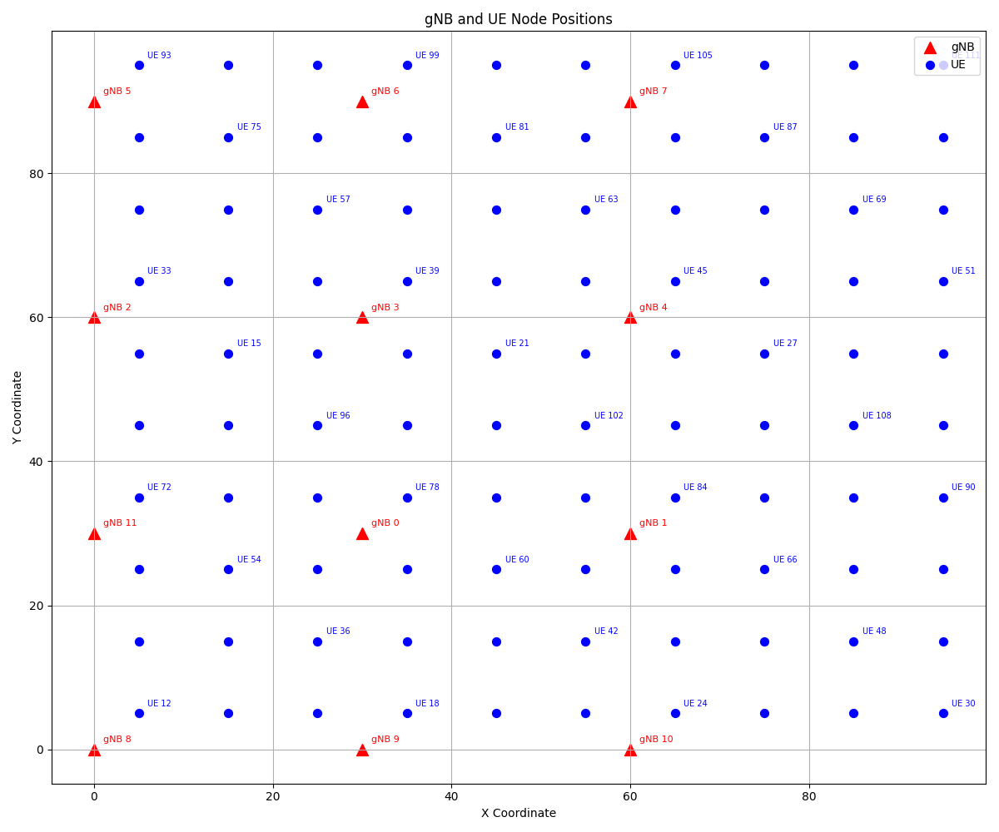
Experiment Setup
Simulator: NS-3 with 5G-LENA module.
Layout: 12 gNBs placed in a 4×3 grid.
UEs: 300 total
150 low-latency UEs with random mobility.
150 voice UEs with static positions.

Slide 11
Experiment Setup
gNB: 2 power configurations (32.3676 dBm and 42.3676 dBm).
FBS: One gNB behaves as a fake base station with (~25%, ~50% and ~75%) power.
UE behavior: Each UE connects to the gNB with the highest RSRP.

Slide 12
Experiment Setup
Dual-band operation: 60 MHz and 50 MHz.
Antenna array: gNB - 4×8, UE - 2×4 isotropic arrays.
Height: gNB - 25m, UE - random(1.5 - 2)m.
Path Loss Model: UMi-Street Canyon.

Slide 13
Data collection
UEs connect to the gNB with maximum RSRP using AttachToMaxRsrpGnb().
During initial access (SSB), UEs scan and record RSRP from all detectable gNBs.
Coordinates of all UEs and gNBs logged using NS-3 NetAnim module.
200 UEs used for training, 100 UEs used for testing.

Slide 14
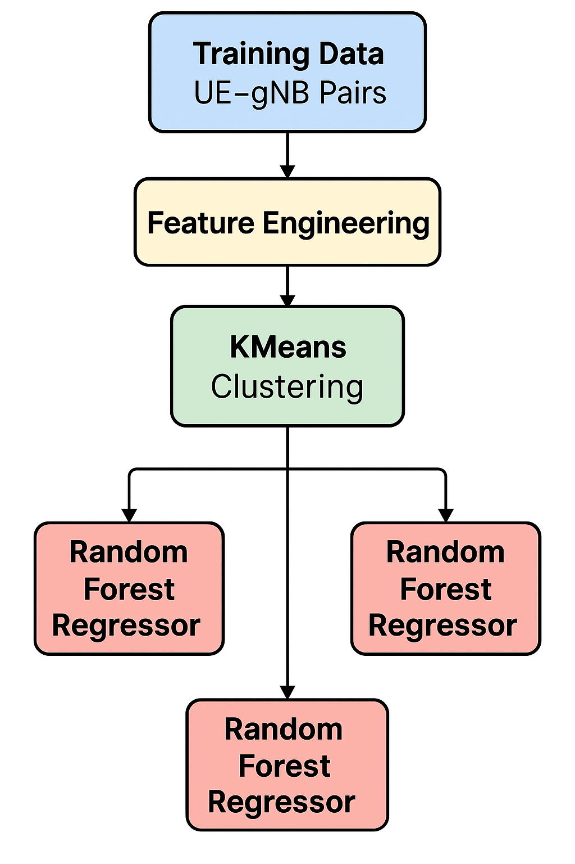
Training Phase
Use RSRP data from 200 UEs (training set).
For each UE - gNB pair
Extract spatial features: distance, dx, dy, log(distance), coordinates.
Apply KMeans Clustering on RSRP values
Cluster 0 → Strong RSRP (UE is close).
Cluster 1 → Medium RSRP.
Cluster 2 → Weak RSRP (UE is far or obstructed).
For each cluster
Train a Random Forest Regressor.
Goal: Learn how RSRP varies with location and distance.
Each model specializes in a specific signal strength range.
Trained models are stored for later use in the testing phase.

Slide 15
Testing phase
Use RSRP data from 100 test UEs.
For each UE - gNB pair within 45m
Extract same spatial features as in training (distance, dx, dy, log(distance)).
Prediction Process
Use trained KMeans to assign the UE - gNB pair to a signal strength cluster.
Apply the corresponding Random Forest model to predict expected RSRP.
Anomaly Detection
Compute residual = | Predicted RSRP – Actual RSRP |.
Aggregate residuals across all UEs for each gNB.
gNBs with high average residuals are flagged as potential fake base stations (FBS).

Slide 16
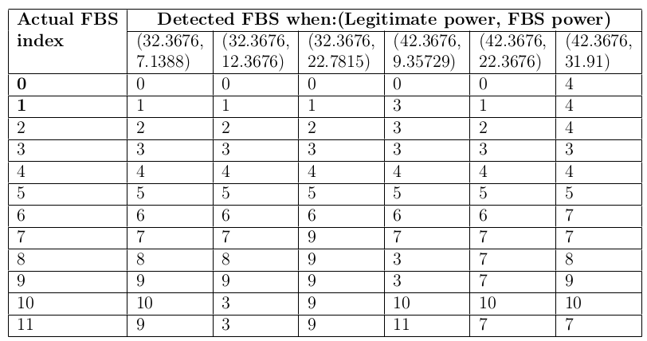
Results: Actual v/s Detected FBS

Slide 17
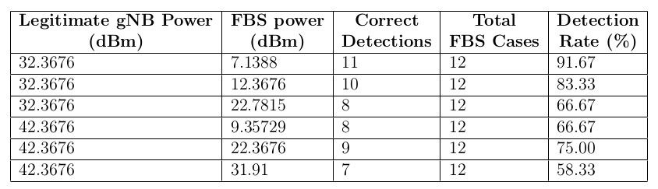
Results: Detection accuracy per power configuration pair

Slide 18
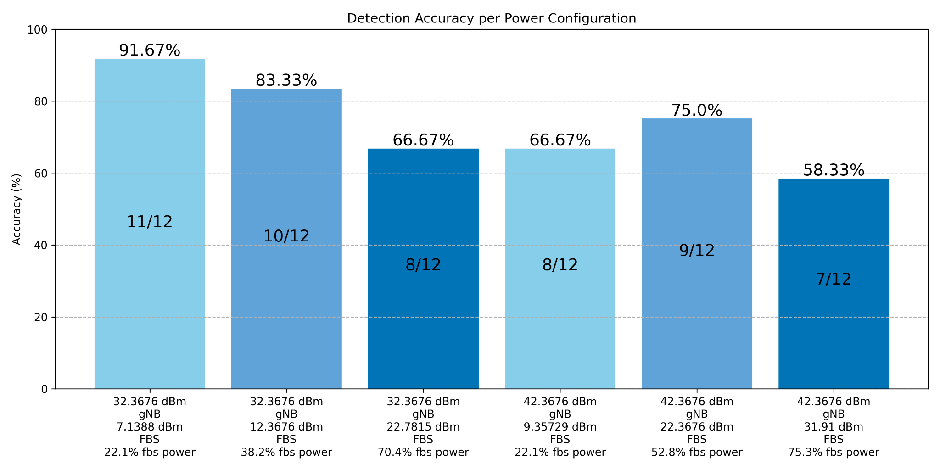
Results: Detection accuracy per power configuration pair

Slide 19
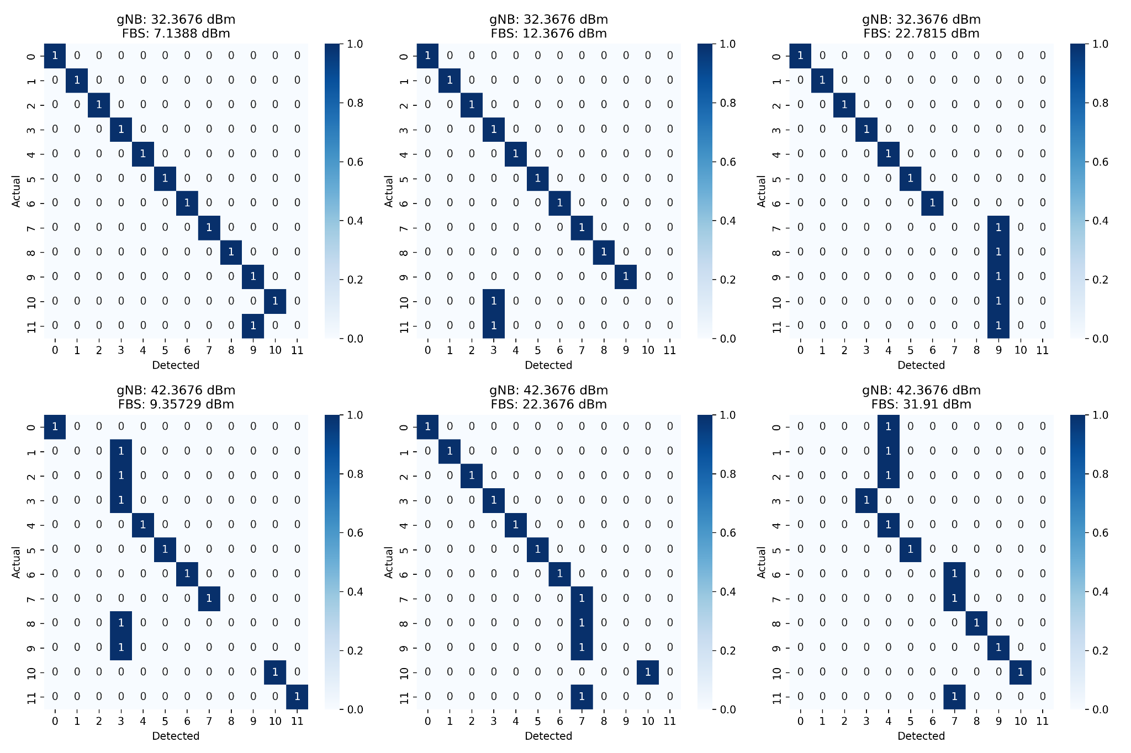
Results: Confusion Matrix

Slide 20
Limitations
Latency
Sending measurement reports to the core and waiting for analysis cause delay.
Processing overhead
Core receive huge data from different UEs that adds up large processing overhead.
Signaling overhead
Transmitting large amounts of measurement data from UEs/gNBs to the core consumes more bandwidth.
Notes:
Sending measurement reports to the core and waiting for analysis cause delay, which might be critical in fast-moving attacks.
Core receive huge data from different UEs that adds up large processing overhead.
there is no label indicating which gNBs are legitimate or fake during real-time operation, so detection must rely entirely on statistical deviation or pre trained ML models.

Slide 21
Other work: srsRAN Enhancement
Implemented the Measurement Reporting feature in 5G Prototype of UE of srsRAN 5g Simulator.
This includes periodic and event-Triggered reporting, calculation of RSRQ, and transmission of these reports to the gNB.
Simulation Setup:
Open5gs as a 5G core.
gNB from srsRAN Project.
5G UE prototype from srsran 4G.

Slide 22
Periodic Reporting
Measurement reports are sent at regular intervals as specified in the RRC re-configuration msg received from gNB.
It allows continuous monitoring.

Slide 23
Event Triggered Reporting
Reports are sent only when certain conditions or thresholds are met, reducing signaling overhead.
These are the events implemented which are specified in 3GPP specification 38.331 for 5G NR:
Event A1 (Serving becomes better than threshold)
Event A2 (Serving becomes worse than threshold)
Event A3 (Neighbor becomes offset better than SpCell)
Event A4 (Neighbor becomes better than threshold)
Event A5 (SpCell becomes worse than threshold1 and neighbor becomes better than threshold2)
Event A6 (Neighbour becomes offset better than SCell)

Slide 24
gNB logs: RRC re-configuration message sent by gNB
……………………………………………
……………………………………………
"reportConfigToAddModList": [
{
"reportConfigId": 1,
"reportConfig": {
"reportConfigNR": {
"reportType": {
"eventTriggered": {
"eventId": {
"eventA1": {
"a1-Threshold": {
"rsrp": 6
},
……………………………..………………
……………………………..………………

Slide 25
UE Logs: Measurement Report prepared by UE
2025-05-13T20:24:34.136856 [RRC-NR ] [D] SRB1 - Tx measurementReport (9 B)
0000: 00 00 05 e4 01 5c e1 ee c0
2025-05-13T20:24:34.136858 [RRC-NR ] [D] Content:[
{
"UL-DCCH-Message": {
"message": {
"c1": {
"measurementReport": {
"criticalExtensions": {
"measurementReport": {
"measResults": {
"measId": 1,
"measResultServingMOList": [
{
"servCellId": 30,
"measResultServingCell": {
"physCellId": 1,
"measResult": {
"cellResults": {
"resultsSSB-Cell": {
"rsrp": 28,
"rsrq": 30,
"sinr": 118
}
}

Slide 26
Measurement Report received at GNB
2025-05-13T20:24:34.166660 [RRC ] [D] ue=0 c-rnti=0x4601: Rx SRB1 DCCH UL measurementReport (9 B)
2025-05-13T20:24:34.166661 [RRC ] [D] ue=0 c-rnti=0x4601: Containerized measurementReport: [
{
"UL-DCCH-Message": {
"message": {
"c1": {
"measurementReport": {
"criticalExtensions": {
"measurementReport": {
"measResults": {
"measId": 1,
"measResultServingMOList": [
{
"servCellId": 30,
"measResultServingCell": {
"physCellId": 1,
"measResult": {
"cellResults": {
"resultsSSB-Cell": {
"rsrp": 28,
"rsrq": 30,
"sinr": 118
]
2025-05-13T20:24:34.166667 [CU-CP ] [D] ue=0: Received measurement result with meas_id=1

Slide 27
Contributions
This work contributes in four ways
Detection happens in a true 5G environment using NS-3 + 5G-LENA.
We analyzed multiple FBS power settings.
We simulate diverse UEs - mobile and static.
We implemented complete 5G measurement reporting in srsRAN 5G to align with 3GPP specs.

Slide 28
Conclusion
FBS can be reliably detected at the core using measurement reports and ML models.
Accuracy of simple ML models reduce if FBS manipulates its power smartly.
Enhanced srsRAN 5G to support full periodic and event-triggered measurement reporting.

Slide 29
Future Enhancements
Localization of FBS using measurement reports.
More advanced ML models based on additional features to reliably detect smart FBS.
Explore edge(UE/gNB) - Core collaborative (distributed) detection.
Extend support for multiple simultaneous FBS detection and localization.
Channel model support in srsRAN 5G UE prototype.

Slide 30
Thank You !!

